Slide 1


Overview
AI-Powered Semantic Hub
(Turning Data into Intelligence)

Slide 2
Problem Statement :
Enterprises struggle to unify semantic models across Fabric, and Azure Analytics service due to manual and error-prone Semantic model creation resulting in inconsistent models, broken dashboards, and delayed insights, while the lack of automation in adapting to new data or schema changes further limits scalability, reliability, and overall system efficiency.
Solution:
LLMs connect to Databricks Delta Tables and intelligently extract schema, relationships, and measures.
AI dynamically creates and updates TMDL-based semantic models .
Generated models are seamlessly deployed to visualization platform for real-time analytics
LLMs to build and maintain semantic models minimal manual process.

Slide 3
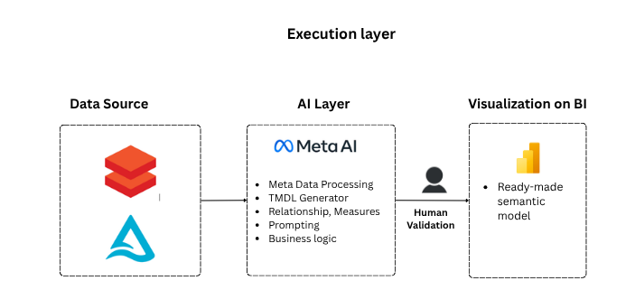
Logical Architecture Overview

Slide 4
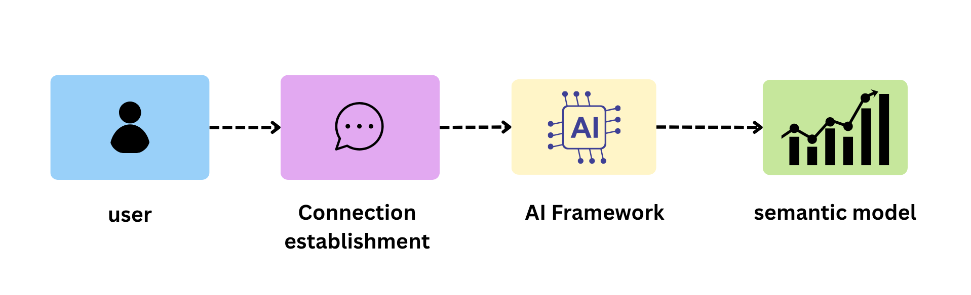
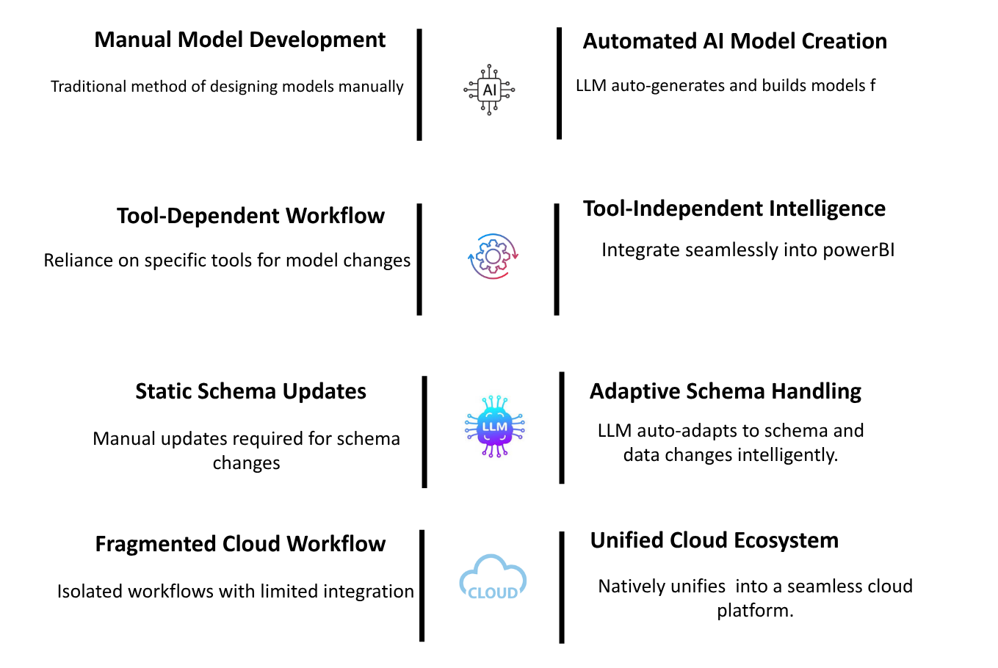
Auto Semantic Hub
Workflow
Tech Stack
Connects to Databricks Delta Tables, where an LLM extracts metadata to create a blueprint for semantic modeling.
Generates TMDL code from metadata and auto-commits to Power BI for instant semantic model deployment.
Includes a human-in-the-loop review to ensure data accuracy and compliance before production.
Before
After
Key Features
Fully automates end to endsemantic model creation.
Connects with Databricks,Microsoft Fabric, and Azure for unified analytics.
Leverages Azure’s infrastructure forhigh performance and low maintenance.
Combines automation withexpert validation for accuracy and compliance.

Slide 5


ssmoses@datapattern.ai
+1 508 654 3779
Time To Transform Is …
… NOW

